Slide 1
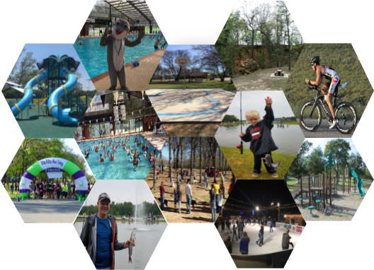
Parks & Recreation
Fast Track Event Planning Guide
cityofdenison.com

Slide 2
Welcome
Thank you for choosing one of our parks and or facilities for your special event!
FAST TRACK EVENT PLANNING INFORMATION PACKET
To conduct a special event at a City of Denison Parks and Recreation Facility, this application must be filled out completely and returned to the Parks and Recreation Department Office, which is located at 300 West Main Street. The following Fast Track Event Planning Guide was developed to assist you, the event organizer, through this approval and planning process. As the event organizer, it is your responsibility to ensure that event participants are provided with a safe and enjoyable event. It is our goal to assist you in planning a safe and successful event.
SCHEDULING YOUR EVENT
As the event organizer, it is your responsibility to research appropriate dates for your event. The Denison Parks and Recreation Department encourages you to check the event schedules of the large annual events. It is also your responsibility as the event organizer to reserve the appropriate site. Submission of this Fast Track Event application, paying the holding fee or damage deposit or hosting the event during the previous year does not guarantee your event the use of the park or facilities.
NEW SPECIAL EVENTS
If you are organizing a new event, your event request will require approval from the Denison Parks and Recreation Department Director. You are required to submit a one page narrative along with the attached application. This narrative will be reviewed by the Parks & Recreation Director. It is imperative that you plan your event far enough in advance to have time to obtain approval. Proposals submitted less than 90 days prior to your event may not be approved. The City of Denison requires advance notice of special events to ensure that public health and safety are provided and protected.
RETURNING SPECIAL EVENTS
If the plans of your event differ significantly from the previous year’s event, your event may require the Department Director’s approval. Examples of changes that require prior approval are: expansion of venue, gated admission, additional stages or structures, and increased anticipated attendance. It is your responsibility as the event organizer to allow for appropriate planning time to secure the Department Director’s approval as well as any additional permits. All Special Events will need to submit the Fast Track Event application in order for the event to be given approval.
The City of Denison Parks and Recreation reserves the right to close down or cancel an event if it is in violation of any city ordinance or deviation from the permit application. The City of Denison also reserves the right to close down or cancel an event if public safety or an affected department deems the event unsafe for public participation.
www.cityofdenison.com
2

Slide 3
Denison Parks & Recreation
Rental Rates & Damage Deposits
Role of Event Organizer
Event organizers will be responsible for communicating with city staff and should submit all required documents by the deadline. All special events are subject to the conditions outlined in this guide and it is the organizer’s responsibility to ensure compliance.
Permit Process
The event organizer should first contact the Parks and Recreation Office to ensure dates are available for the proposed event. Events returning for a successive year or “returning event” may be given priority consideration.
Fees due on submission must be in the form of a check, money order, or credit card in the name of the organization stated on the application and shall be made payable to the City.
Once an application has been submitted, the Parks and Recreation Office will contact the event organizer to schedule a review meeting. Event organizers are encouraged to attend the review meeting to answer any questions and expedite the approval process. The Parks and Recreation department will do its best to accommodate applicants in the time applications are received and when the event is to take place.
Follow-up
There will be a follow-up meeting scheduled with Parks and Recreation staff to review the event and make recommendations on moving forward. The Parks and Recreation Department will contact the event organizer to schedule the meeting.
If the event is successful and there are no issues, it will be eligible for a Save the Date with the City. This process will be discussed at the follow-up meeting.
Deadlines and Fees
Fee | Deadline | Amount | Refundable
Amplification Fee (if needed) | On submission | $50 | N
Security Services (if needed) | After review | $35/hr | N
Fire/Emergency Services (if needed) | After review | $35/hr | N
3 yd dumpster | After review | $75 each | N
20 yd dumpster | After review | $475.65 each | N
www.cityofdenison.com
3

Slide 4
Denison Parks & Recreation
Policies and Procedures
All legislation, bylaws, regulations, and City of Denison Code of Ordinances must be adhered to.
A zero-tolerance policy is enforced for all special events. Failure to comply with standards could result in refund loss, cancellation of event, or disruption of future events.
The event organizer is required to provide evidence of all the necessary licenses and permits needed for the event. They are also required to submit an Emergency Plan with the permit application.
All special events must comply with current ADA standards to ensure all residents are able to participate.
Under Chapter 11 of City of Denison Ordinance-
(b) It shall be unlawful for any person to possess any firearm: (1) while within the boundaries of a public park, except a person licensed to carry a handgun in accordance with V.T.C.A., attending or in the presence of a public meeting except a person licensed to carry a handgun in accordance with V.T.C.A., Government Code ch. 411, subch. H, may carry a handgun if not prohibited by other law; (3) on the premises of any government court or offices utilized by the court, unless pursuant to written regulations or written authorization of the court; (4) while attending a political rally, political parade or official meeting of a political party or interest group; or (5) while attending a non-firearms related school, college, or professional athletic event.
(c) It shall be unlawful for any person to possess a firearm or handgun while on municipally-owned premises, except a person licensed to carry a handgun in accordance with V.T.C.A., Government Code Ch. 411, subch. H, may carry a handgun if not prohibited by other law.
No person may be permitted at any special event to: sell firearms or prohibited weapons, carry or sell illegal drugs, carry or sell alcohol.
Facilities will not be used for anything other than what is permitted by Parks and Recreation Director.
Any events held in the Entertainment District, please refer to Article VI of the Denison Ordinance for more information regarding rules and regulations.
The Parks and Recreation department or its designee may vary any element of this policy at their sole discretion.
www.cityofdenison.com
4

Slide 5
Denison Parks & Recreation
Policies and Procedures
Insurance
The special event must carry property, bodily injury, and municipal liability insurance of $1,000,000.00 per occurrence. The City of Denison must be shown as an additional named insured on the insurance declaration. One original copy of insurance must be submitted at least 30 days prior to the event.
Cancellation insurance may be purchased to cover City man hours and supplies in the event that an event is cancelled.
At its discretion, the City of Denison reserves the right to set higher insurance limits. This may be required depending on the type of activity planned during the event.
The event organizer shall indemnify and hold the City of Denison harmless from and against all liability, loss, claims, demands, costs, and expenses, including reasonable legal fees, occasioned wholly or in part by any negligence or act of omissions by the above names, their officers, agents, employees, volunteers, or others for whom they are responsible at law, arising out of any cause whatsoever, either direct or indirect, through its use and/or operation of city property in connection with the special event.
Park Reservation
The event organizer must contact the Parks and Recreation Department at 903-463-5116 to reserve the space. You can also reserve your space online at Denison.RecDesk.com.
www.cityofdenison.com
5

Slide 6
Denison Parks & Recreation
Policies and Procedures
Safety
Emergency services-
Denison Public Safety will review the public safety components of the event to determine if on-site personnel are necessary. A Fast Track Event Command Team will be composed if it is determined one is needed and the event organizer will be responsible for the cost identified.
The City of Denison requires an emergency plan for all events in accordance with Chapter 4 of the International Fire Code 2012 Edition. The plan must address how the event organizers will deal with concerns of emergency services and fire. If the organizer needs assistance or has specific questions, they can contact the Emergency Management Coordinator at 903-465-2720 ext. 2212 or mmetcalf@cityofdenison.com.
The below items shall be addressed in the emergency plan-
-Emergency vehicle access and exit
-Emergency medical responses and calling 9-1-1
-Directing attendees to evacuate in the event of an emergency
-Overall fire protection plan for the event
-Need for law enforcement and/or fire and EMS presence
At no time may the activities of the event restrict access to the street by police and fire vehicles. Fire hydrants shall not be blocked at any time and a clearance of at least 6 feet around hydrants must be maintained. There must also be a clear and unobstructed path from the street to the hydrant. Objects including ropes shall not be attached to fire hydrants at any time.
In the event an emergency vehicle must enter the event area, persons should be designated to be available to more barricades, tables, chairs, etc. if necessary.
If emergency vehicles are requested to respond to your event, the designated personnel must immediately go to the appropriate barricades and standby. This will prevent any delays.
All emergency and fire services must be coordinated with the Denison Fire Department. If fire or EMS services are deemed necessary the cost of services is $35 per hour with a 2-hour minimum per person paid to the City.
Security-
The need for security services will be evaluated by the Denison Police Department per event. The cost of special/additional support will be the responsibility of the event organizer. If there are any concerns about security the event organizer will be contacted prior to the event being reviewed. If police services are deemed necessary, the cost of services will be $35 per hour with a 2-hour minimum for each individual officer paid to the City.
www.cityofdenison.com
6

Slide 7
Denison Parks & Recreation
Policies and Procedures
Outdoor Activities
Tents and canopies- A permit is required when a tent structure or canopy has an area in excess of 400 square feet. For uses where several smaller tents (10X10) are used and these are located directly adjacent to one another, a permit may be required subject to the review of the Fire Marshal.
Parades-
All parade participants must begin and end at the staging area. Floats and participants should not leave the parade route early. The same rules and regulations regarding litter control apply to the parade staging area and route. Parades must submit a traffic control plan and parade map with application.
Event Infrastructure
Parking-
Any parking that is going to be utilized that is not public access parking requires an application. The event organizer must request a location for parking as well as describe where there should be access, handicap spaces, how many and what type of vehicles are to be expected, and who will handle the coordination on the application. A letter of approval is required from any and all property owners and must be submitted with the application if alternate parking lots are going to be used.
Drones-
If drones are being used at the event, note that all federal regulations apply. The Remote Pilot in Charge, primary and secondary landing zones, type of drone, and the registration number must be included on the application. The City of Denison reserves the right, due to unsafe operations, to suspend all flights during the event and could result in suspension at future events.
www.cityofdenison.com
7

Slide 8
Denison Parks & Recreation
Policies and Procedures
Noise-
Event organizers should be mindful of the impacts of sound to the surrounding neighborhoods. Noise issues fall subject to the guidelines of Article 5 of the Denison Code of Ordinances. The creating of any unreasonably loud, disturbing and unnecessary noise within the corporate limits of the city is prohibited. Any noise of such character, intensity or duration as to be detrimental to the life or health of any individual, or in disturbance of the public peace and welfare, is prohibited. The City requires an amplification permit under Article 5, Section 13-99, for any outdoor event that will have outdoor amplification. The non-refundable fee is $50 and due at the time of the application. It is the responsibility of the event organizer to understand and comply with the noise levels outlined in Article 5 of the Denison Code of Ordinances. Penalty for not obtaining an amplification permit may be up to $2,000.
The City reserves the right to shut down any event that is in violation of the noise level ordinance.
Site Cleanup and Waste Management-
The event organizer is responsible for the cleanup of the location to the satisfaction of the maintenance department or designee. If litter is left at the event site, the city reserves the right to charge the event organizer for clean-up.
The removal of garbage must be completed at the end of the event unless otherwise specified and approved. The city will provide all normal maintenance services to its current routine standards including but not restricted to, mowing, ice clearing, and regular janitorial services before and during the event. Any additional maintenance required by the event prior to or during the event may be at the cost and responsibility of the event organizer.
The City of Denison will not supply any additional garbage containers over and above the current level for special events without prior notification. It is the sole responsibility of the special event organizer to notify the city of collection service needs for the event. If extra dumpsters are required, requests must be made prior to the event and submitted on the permit application. Fees are listed in the Deadline & Fee section of this guide. Containers for recycling will be available and used for beverage cans and bottles. The event organizer will ensure that there is a suitable location for vendors to place flattened cardboard boxes. These are to be kept separate from any other recyclables or garbage.
www.cityofdenison.com
8

Slide 9
Denison Parks & Recreation
Policies and Procedures
Bathroom Facilities-
The following should be considered when determining the number of toilets needed for the event.
-Duration of event
-Weather
-Crowd size
-Ticketed or un-ticketed event
The minimum requirement is 1 toilet per every 300 attendees.
For more information on portable bathroom facilities, please visit the Portable Sanitation Association website.
Alcohol
No alcohol will be distributed or consumed in city parks and/or streets in accordance with City Ordinances.
Under Chapter 3 of the Denison Code of Ordinance, the consumption of alcohol is excepted for the T-bar Softball Park during the adult league play or tournaments.
Any event that will be serving or selling alcohol must contact the City Secretary at 903-464-4440 for more information on a Temporary Alcohol, Catering, or Winery Festival Permit Application.
Food
Any food served or sold at the event requires a permit under Chapter 3 of the Denison Code of Ordinance. To acquire the proper permit application, visit the Grayson County Health Department website or call 903-465-2878.
Advertising
It is the responsibility of the event organizer to ensure affected residents and businesses fully understand the impact of the event. Event organizers must contact the Parks and Recreation Director for campaigns.
Signs cannot be attached to trees or utility poles, fences or outside of abandoned buildings. Refer to Chapter 31 of the Denison Code of Ordinances for more detailed sign information.
www.cityofdenison.com
9

Slide 10
FEES AND DEPOSIT INFORMATION - Non-refundable deposit is due 15 days prior to scheduled event. The non-refundable deposit will be applied to overall fee if rental is completed. - Lights are included in rental. - No sub-renting of fields is allowed at any time. - Individual gate fee will be allowed by the rental applicant, if elected to do so. - Food and drink concessions will only be provided and operated by the City of Denison. - An invoice will be sent to the rental applicant the next business day following the conclusion of the rental. The rental applicant must pay the invoice within 3 business days from invoice date. Failure to pay the invoice within 3 business days will be subject to forfeit any future rentals. - If damage is found or litter is left in the dugouts or on the field, additional fees could be assessed to the rental applicant. - Refunds will only be issued because of weather related cancellation. RESERVATIONS PROCEDURES / APPLICATIONS - Rental applications must be made at least 15 days prior to the start of the event, with the non-refundable deposit paid. A copy of insurance must also be submitted to the City of Denison. - Prior to the event, the applicant must submit a tournament schedule/bracket, covering the entire length of the reservation. Failure to supply the above requirements in the time indicated could cause the reservation to be cancelled. - A copy of the completed tournament schedule/bracket will also need to be provided after completion of rental. - A list of tournament teams with state and city. - Events may be run between the hours of 8:00AM and 10:30PM. This does not include set up and clean up time. Set up and clean up time must be submitted in rental application and have approval of Denison Parks and Recreation Department. - All additional requests must be included in the application. SERVICES INCLUDED IN THE RESERVATION OF FIELDS - Facility will be cleaned and prepped for tournament. - Facility will be lighted if the event is scheduled for night use. - Use of score boards should be requested by rental applicant. The rental applicant shall provide personnel to operate the scoreboard controllers and will be liable for any damage. INSURANCE - The policy shall name the City of Denison (300 W. Main St Denison, TX 75020) as additional insured. Insurance is due, at minimum, 2 days prior to the tournament.
Denison Parks & Recreation
Policies and Procedures
www.cityofdenison.com
10

Slide 11
Denison Parks & Recreation
THF Code of Conduct
PLEASE OVERCOMMUNICATE THE CODE OF CONDUCT TO ANY VISTORS THAT WILL BE IN ATTENDACE!
The following Code of Conduct is applicable to all who visit or participate in THF Park programs, services, and activities. As a participant or visitor, you agree that you will:
Behave in a courteous and respectful manner towards others. All users are required to conduct themselves in a manner that does not interfere with another person’s enjoyment of THF Park.
The multipurpose fields and baseball/ softball fields are intended for game use ONLY. Fields SHOULD NOT be used for practice or free play.
Metal spike cleats are not allowed on THF Park fields. Molded cleats or turf shoes only.
Use all equipment and facilities at your own discretion and risk.
Refrain from behavior or language that is abusive, threatening, inappropriate, or disruptive to others, which may result in expulsion from the Park.
Dress in attire appropriate for the activity. Inappropriate, dangerous, or revealing attire, as determined by THF Park staff, may result in expulsion from the Park,
Food and non-alcoholic drinks are allowed in THF Park, but are not allowed on the Sand Volleyball court, Splash Pad, Playground, Exercise Station, or Walking Trails, except for water in a plastic, closed container. No glass containers may be used. Coolers are allowed.
RV’S, chewing gum, sunflower seeds, and shelled peanuts are not allowed at THF Park.
Participants must dispose of trash or waste appropriately.
Ensure pets remain on leashes and under control at all times. Pet owners are required to collect and dispose of waste properly.
Refrain from destruction or defacement of City property, including littering.
Responsibly secure your own personal belongings. THF Park is not responsible for lost or stolen items.
Keep THF Park a drug, alcohol, and tobacco-free environment and promptly report all illegal drug, alcohol, and tobacco usage immediately.
Refrain from providing professional services for compensation, including photography, exercise or sport training, or food sales. Only authorized vendors may provide professional services within THF Park. (Parties interested in becoming an authorized vendor should contact the manager on duty for information.)
Follow all written rules as well as verbal directions by THF Park staff. Patrons and guests violating any THF Park guidelines may be required to leave THF Park, forfeit paid fees, and be prohibited from future use of THF Park.
Renters Initials: _________
11

Slide 12
Denison Parks & Recreation
Park Reservation
Permission from Denison Parks and Recreation has been given to the person signing this form to use the Park facility for the date and time specified herein.
Name/Event Type: _________________________________________________________________
Date of event: _________________ Time of event: ____________________________________
Email address: __________________________________________________________________
Reservation made by: _____________________________________________________________
Organization: ____________________________________________________________________
Address: _________________________________________ City, State: _____________________
Phone: _______________________ Alt Phone: ________________________________________
Area(s) of Park reserved: ___________________________________________________________
Estimated Number of Participants: __________ Blocks of time: ____________________________
Please Read and Sign
I fully understand that I am responsible and liable for any damages to the above premises. I understand that I am responsible for the conduct of all participants. I understand that additional fees could be charged if the facility/field is left unclean and/or damaged. I understand and agree to abide by all City of Denison policies, ordinances, rules and regulations. I also understand that the City of Denison is not liable for any accidents, which may occur during the time of my reservation.
____________________________________________________________________________________
RENTERS PRINTED NAME RENTERS SIGNATURE DATE
www.cityofdenison.com
12

Slide 13
Denison Parks & Recreation
Park Reservation
If this event has been held before, have there been any changes made? __________ If yes, please explain.
___________________________________________________________________________________________________________________________________________________________________________________________________________________________________________________________________________________________________________________________________________________________________________________________________________________________________________________
Please describe the event more in detail. (Age groups, Game guarantee, etc.)
__________________________________________________________________________________________________________________________________________________________________________________________________________________________________________________________________________________________________________________________________________________________________________________________________________________________________________________________________________________________________________________________________________
If the event is open to the public, please circle all advertisement methods you plan to utilize:
Print TV Radio Website Social Media Posters/Signs Other: __________________________
If using posters/signs, where will they be displayed?
_______________________________________________________________________________________
Will water need to be made available for the dugouts? Y N
Will the event require portable restrooms? Y N
How many? _________ (Min. requirement is 1 to 300 participants)
If needed, where will the portable restrooms be located?________________________________________
Will any merchandise be sold? Y N
If so, please list all items:__________________________________________________________________
Use of Scoreboards? Y N
www.cityofdenison.com
13

Slide 14
Denison Parks & Recreation
Park Reservation
The undersigned, on behalf of myself, my organization, my heirs and my assigns, and in consideration of my use of the property, named on this form, of the City of Denison does hereby waive, release, absolve, indemnify, and agree to hold harmless the City of Denison from any liability whatsoever for damages for injury to any person or property resulting in any way from the undersigned’s use of said property.
_______________________________________________________________________________________
RENTERS NAME RENTERS SIGNATURE DATE
_______________________________________________________________________________________
STAFF NAME STAFF SIGNATURE DATE
**NO ALCOHOLIC BEVERAGES ARE ALLOWED IN ANY CITY FACILITY AT ANY TIME**
Refund Policy
Weather related cancellation will be rescheduled or refunded.
**Please allow up to 30 days for any refund checks to be mailed to the address above. Checks cannot be picked up from Denison Parks and Recreation Department.
Contact Numbers: Monday-Friday 8am-5pm 903-465-2720/ After Hours and Weekends 903-647-0284
******************
FOR OFFICE USE ONLY: Receipt #: ____________________
Reservation received: ___ In Person ___ Email ___ Fax ___Mail ___Phone
Payment type: ___ Credit/Debit Card ___ Cash ___Check/Money Order
Non-Refundable Deposit: $__________ Rental Fee: $___________Total: $___________
Application Checklist
_____ Emergency Plan _____ Course route, if applicable
_____ Map of event _____ $50 amplification fee, if applicable
_____ Proof of insurance _____ Park reserved, if applicable
_____ Traffic plan, if applicable
www.cityofdenison.com
14

Slide 15
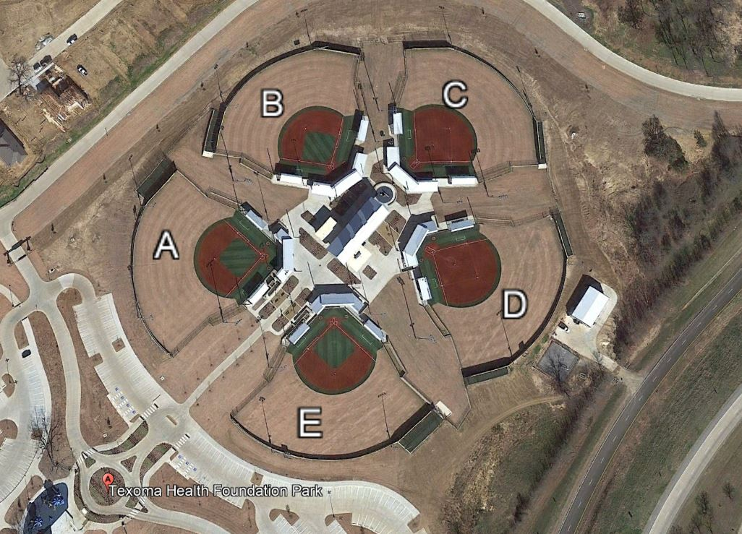
Denison Parks & Recreation
Tournament Details
Name of Tournament Director: _____________________________________________________________
Phone:_____________________ Alternate Phone: ____________________ Use of Scoreboards? Y N
Individual gate fee? Y N If yes, what prices will be charged? ____________________________________
Time including set-up and take down: _______________________________________________________
Will the Set up be the same for both days? ____________________________________________________
Number of Teams or Participants: _____________________ Age groups: ____________________
Special Request(s):________________________________________________________________________
Please write in the parameters you are requesting for each field being used.
Field A (Baseball Look)
Pitching distance ______ ft
Bases set at______ ft
Age Group ______
Baseball or Softball
Field C (Softball Look)
Pitching distance ______ ft
Bases set at______ ft
Age Group ______
Baseball or Softball
Field E (Baseball Look)
Pitching distance ______ ft
Bases set at______ ft
Age Group ______
Baseball or Softball
Field B (Baseball Look)
Pitching distance ______ ft
Bases set at______ ft
Age Group ______
Baseball or Softball
Field D (Softball Look)
Pitching distance ______ ft
Bases set at______ ft
Age Group ______
Baseball or Softball
www.cityofdenison.com
15

Slide 16
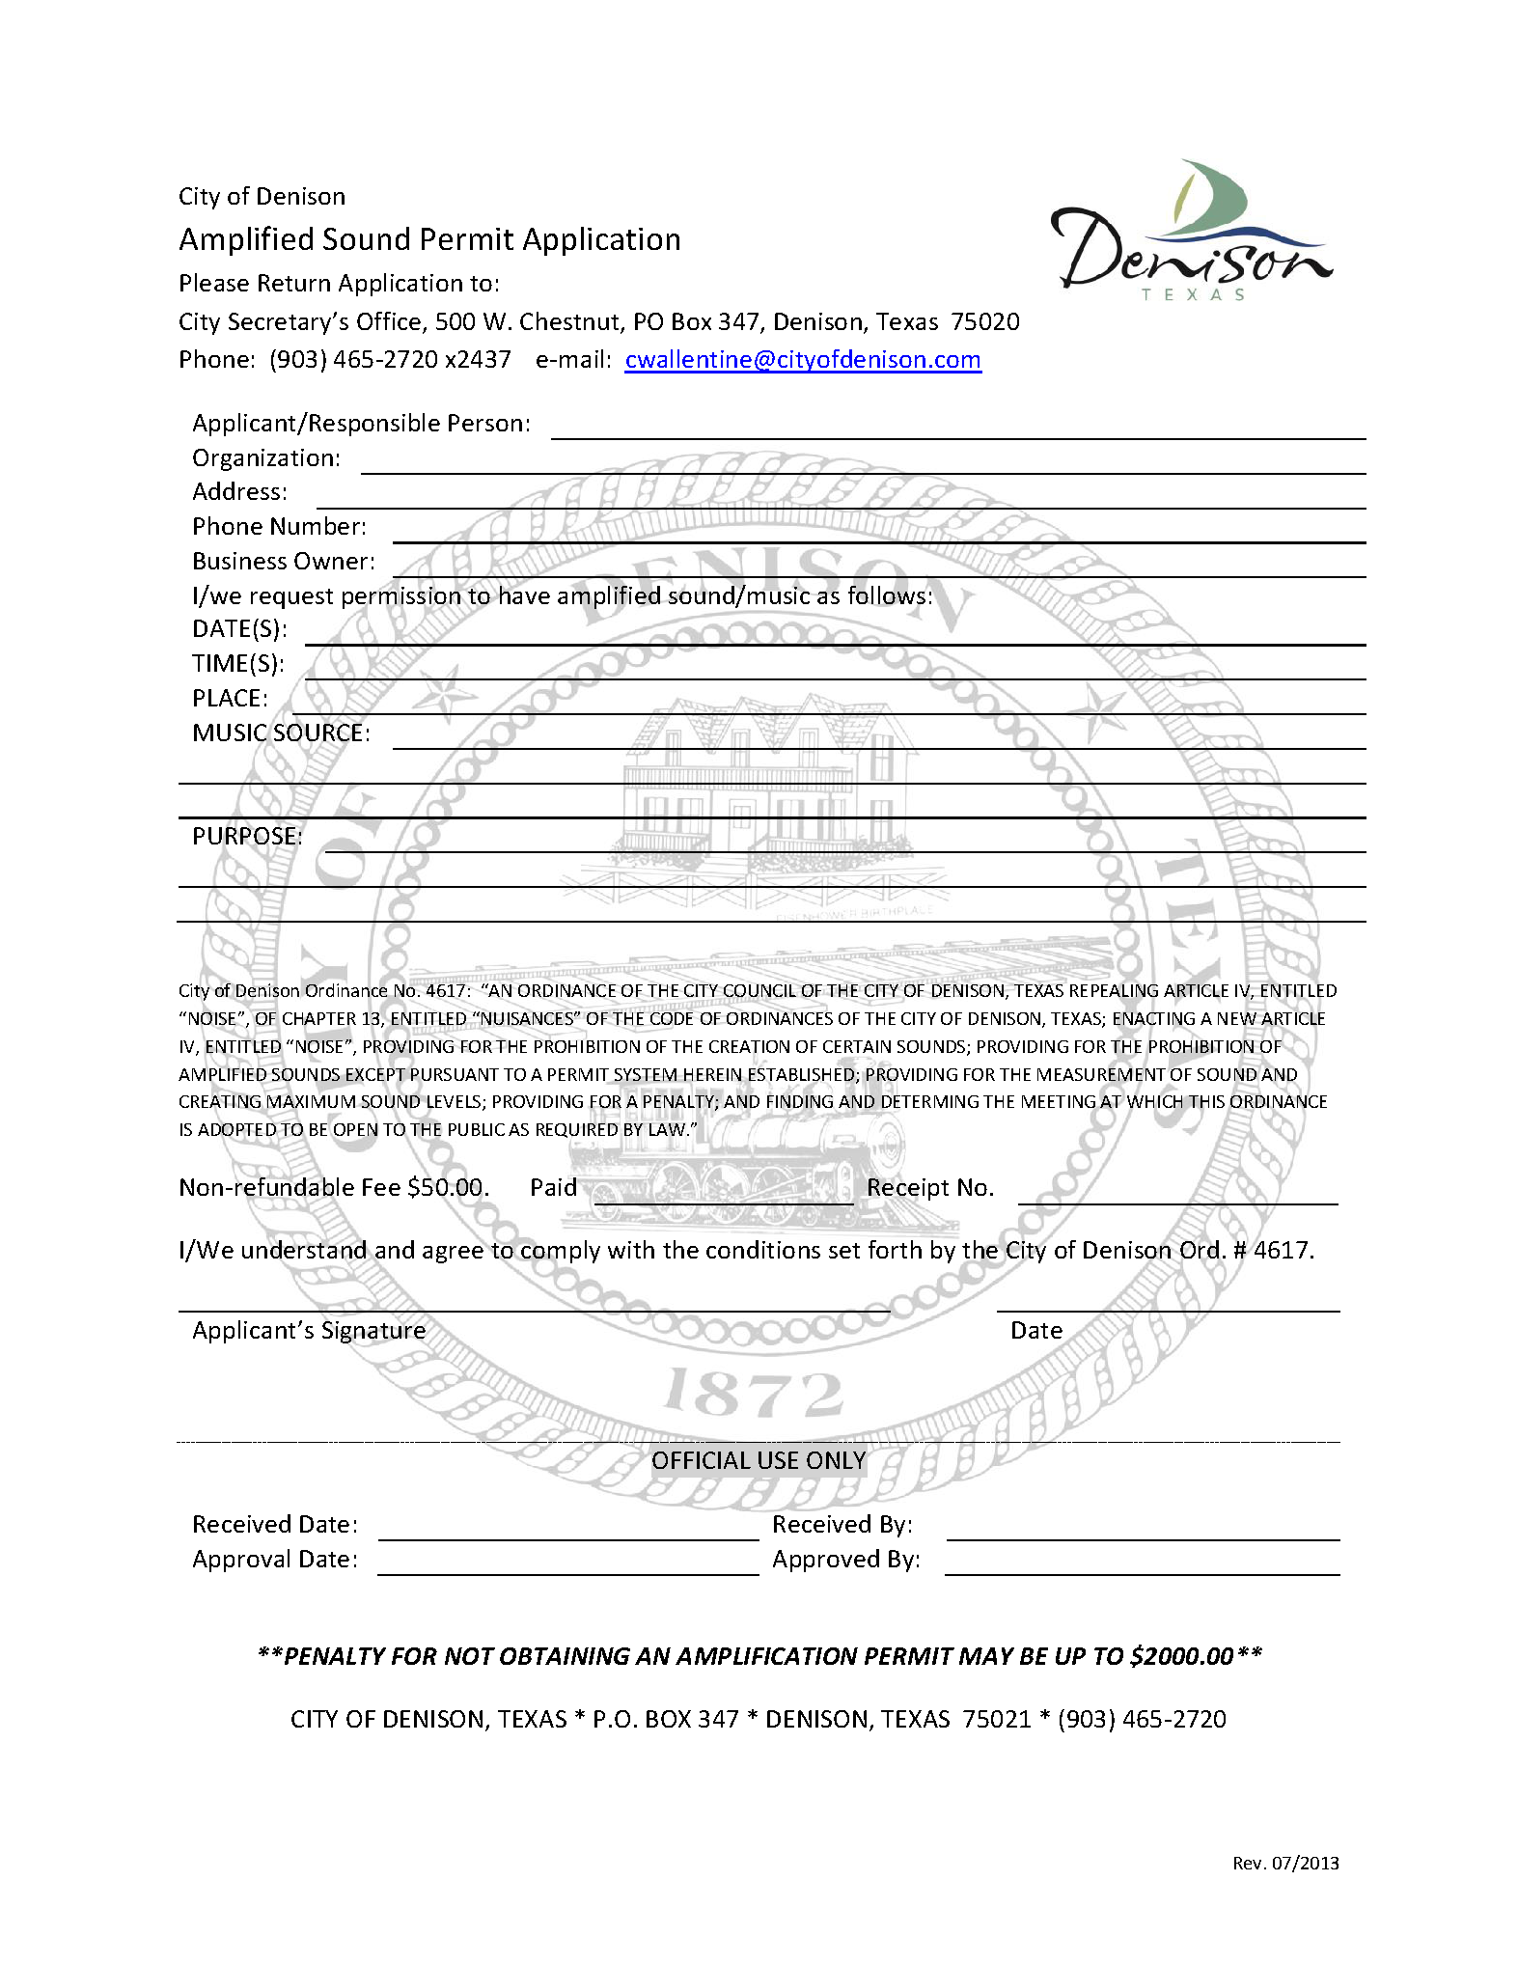
Denison Parks & Recreation
Amplification
www.cityofdenison.com
16

