Slide 1
City of Denison Town Hall Meeting
Thursday, February 13, 2020

Slide 2
Welcome & Introductions
February 13, 2020 town hall meeting
Janet Gott, Mayor
Judson Rex, City Manager

Slide 3
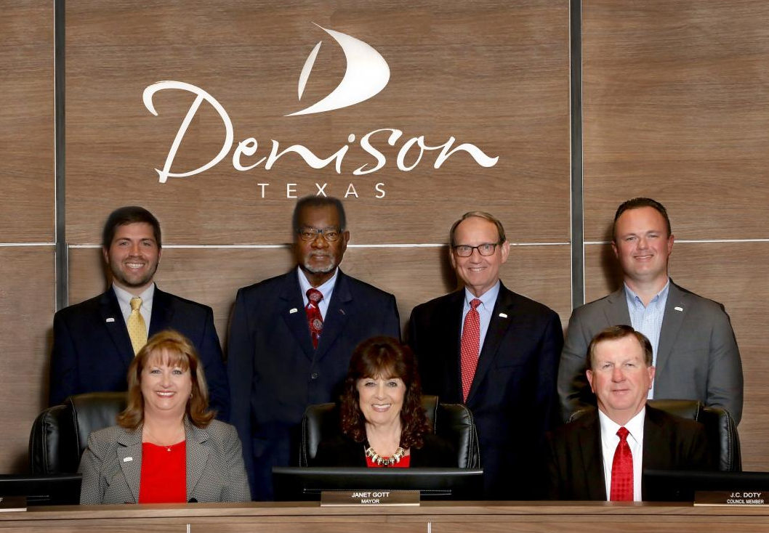
Your City Council
Mayor Janet Gott (Place 7)
Mayor Pro Tem Teresa Adams (Place 1)
Obie Greenleaf (Place 2)
J.C. Doty (Place 3)
Robert Crawley (Place 4)
Kris Spiegel (Place 5)
Brian Hander (Place 6)

Slide 4
Tonight…
Welcome & Introductions:
Judson Rex, City Manager
Comments:
Mayor Janet Gott
Dr. David Kirkbride
Denison Neighborhood Revitalization Initiative:
Robert Lay, Code Compliance/Animal Services Manager
Kimberly Murray, Director of Community and Development Services

Slide 5
VISION: Become the community of choice by creating an excellent quality of life.
“Within thirty (30) years, the City of Denison will be known as a thriving, regional leader that other communities strive to be like, and where people consciously decide to live and locate their businesses. It will be a beautiful City, with quality, well maintained housing for all income levels. It will serve as a regional employment center and provide a rich and varied shopping experience. It will be a community that offers regionally renowned parks and recreation facilities and it will be well known for enjoying an excellent quality of life.”

Slide 6
Denison Neighborhood Revitalization Initiative

Slide 7
Revitalization Initiatives Moving Denison Forward
1) Code Compliance Overview and Strategies
2) Revitalization Programs and Incentives
3) Investing in your Neighborhood

Slide 8
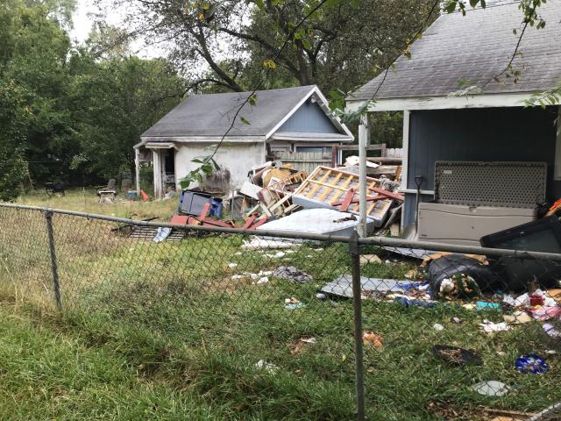
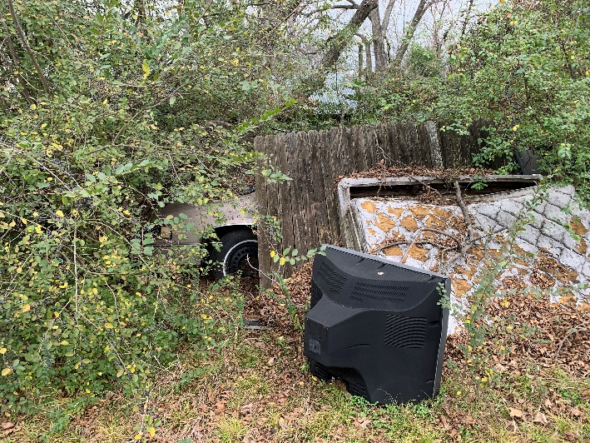
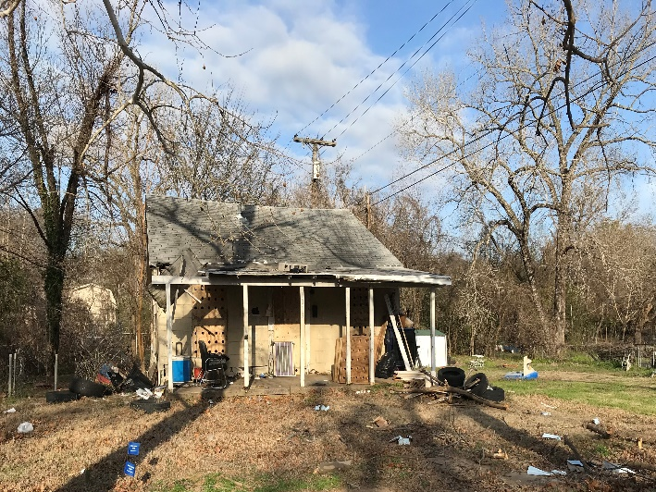
What is Code Compliance
The goal of code compliance is to gain compliance for violations and educate citizens about City ordinances
State certified Code Officers enforce City ordinances to help keep citizens safe, protect property values, and keep the city an attractive place to live
Common Violations worked within the city limits include:
-Tall Grass, vehicle violations, accumulation of litter/debris and property maintenance violations

Slide 9
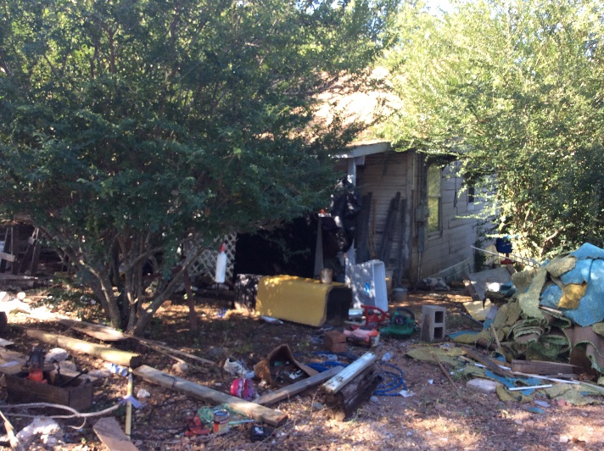
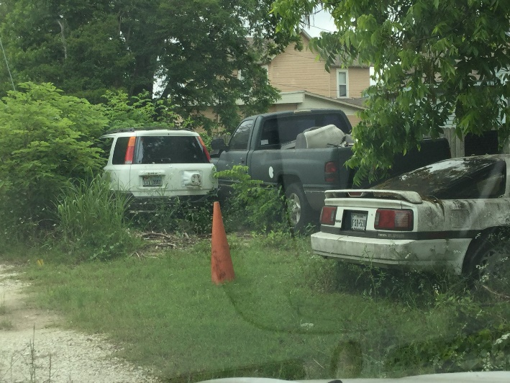
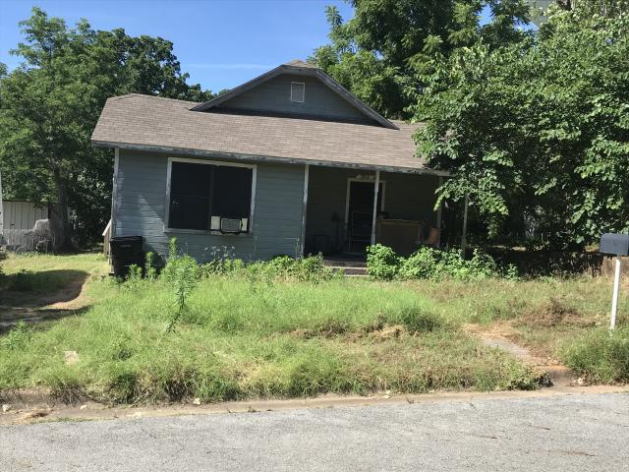
Common Code Violations
Litter and Debris Junked Vehicles High Grass and Minimum Property Standards

Slide 10
Code Compliance Team by Area North Area - Carla Brown Central Area - Michael Fitzpatrick South Area - Novardo Johnson

Slide 11
Meet Novardo Johnson, Code Compliance Officer

Slide 12
2019 Code Compliance Report
7,010 Cases Initiated / 6,852 Completed
- 692 (Sign Violations and Obstructions)
- 859 (Illegal Parking, Junked Vehicles or Inoperable Vehicles)
- 2,909
- 968
- 275 (Sub-Standard Structures, Unsafe Structures, No Water)

Slide 13
Code Compliance Process Map

Slide 14
Code Compliance Strategies Moving Denison Forward
1) Minimum Property Standards
Corridors
Schools
Parks
4) Other strategies to Promote Code Compliance Initiatives
Penalties Ordinance, Nuisance Ordinances and Unsafe Structure Ordinances
Zoning and Signs
Recommendation for Additional Compliance Officer
2) Strategic Neighborhood Focus
3) Unsafe Structures and Demolitions

Slide 15
Minimum Property Standards
1965 - Median Year for Homes Built in Denison
Ordinance Passed in 2012 addresses the exterior structure of homes and businesses:
Painted and Weatherproofed
Free of Rotten Wood and Broken Windows
Free of Visible disrepair to Roofs
Conditions of exterior grounds included like accessory buildings and fences
Since 2012: 745 Cases Initiated and 102 On-Going Cases

Slide 16
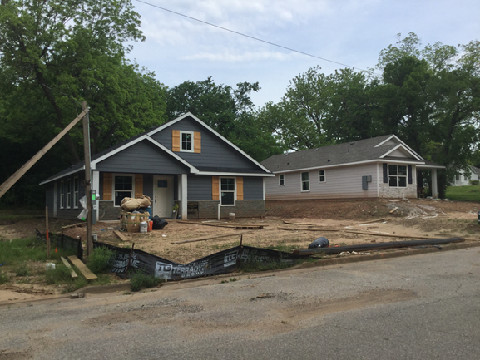
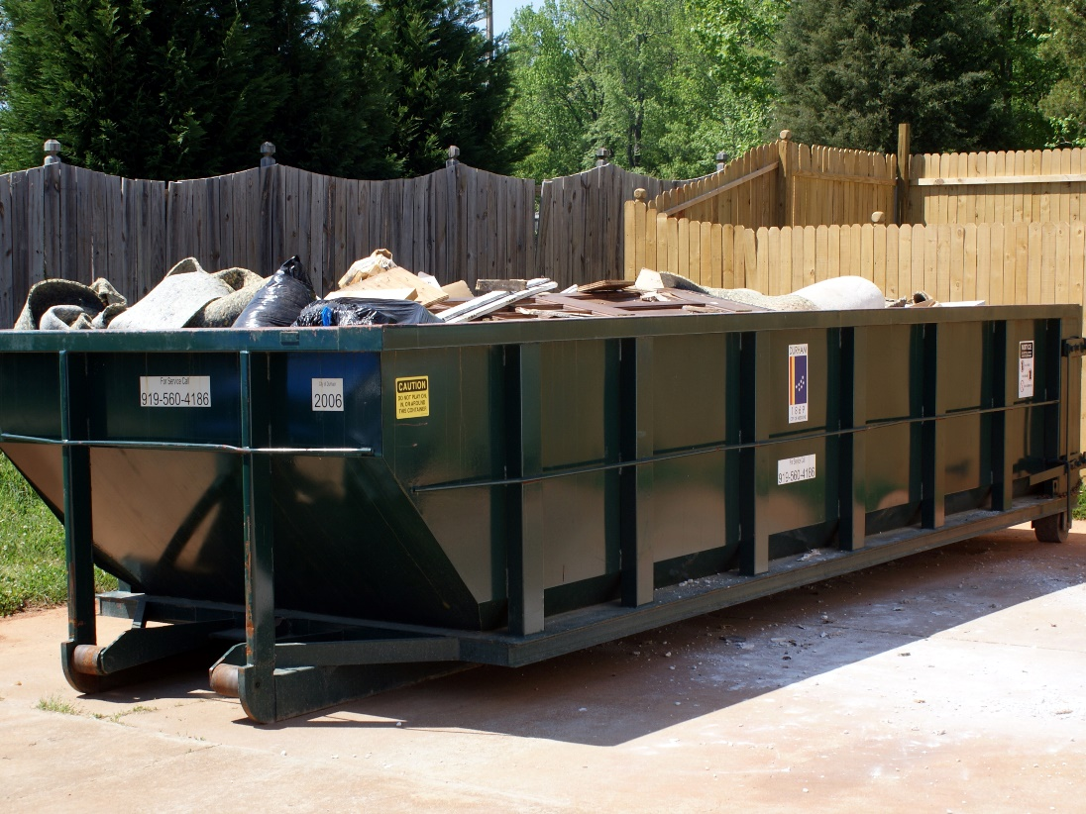
Strategic Neighborhood Focus
Specific efforts in neighborhoods that have seen recent redevelopment and current redevelopment
Looking into city sponsored block party neighborhood clean up with Code staff support
This Photo by Unknown Author is licensed under CC BY-SA

Slide 17
Minimum Property Standards Success at 2 Loy Drive

Slide 18
Minimum Property Standards Success at 1611 W. Morton St.

Slide 19
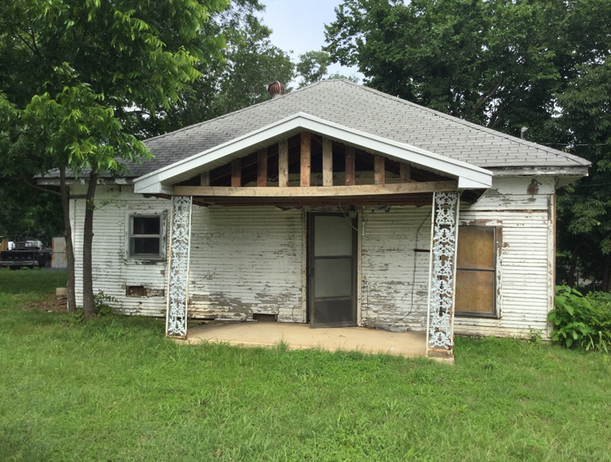
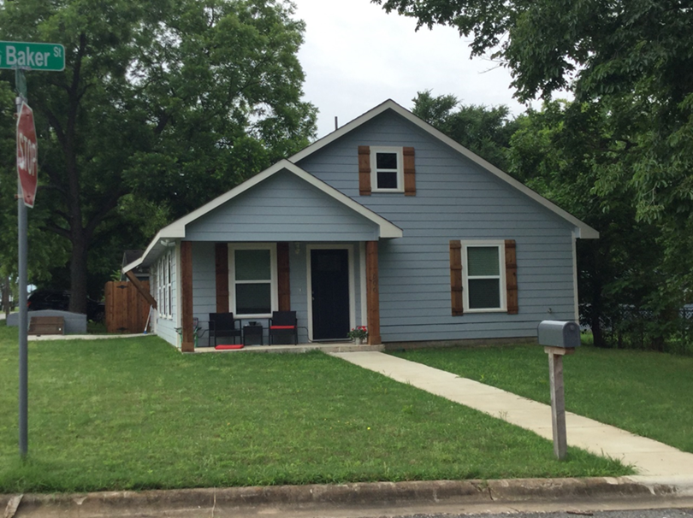
Unsafe Structure and Demolition Program
450 Unsafe Structures demolished since 2010
Over 60 new homes built on lots

Slide 20
Revitalization Programs Moving Denison Forward
Residential Remodel Incentive Program
CDBG Emergency Home Repair Program
Downtown New Construction Incentive Program
Rental Registration and Inspections Program
DDA Façade Grant Program

Slide 21
Residential Remodel Incentive Program
Incentive Program focused on the rehabilitation of existing homes
Projects that meet all requirements and add at least $40,000 of increased taxable value are eligible for a cash rebate of 10 times the amount of new assessed taxable value
70 Projects completed in last few years
$1.82 million in new home values have been added under the program

Slide 22
CDBG Emergency Home Repair Program
Community Development Block Grant (CDBG) Program
Federally Funded Grant through the Department of Housing and Urban Development (HUD)
CDBG Emergency Home Repair Program has $39,384 in 2020
Recipients must apply and qualify as low to moderate income
A maximum of $4,000 can be spent on any residence as set by CDBG Steering Committee
Examples of Qualifying Projects include: Installation of water heaters and other plumbing repairs, roofing repairs, installation of handicap accessibility ramps and exterior maintenance to address Minimum Property Standards violations
Since 2015, 157 projects have been completed with CDBG Funds

Slide 23
Downtown New Construction Incentive Program
Newest Building Incentive Program kicked off in Fall 2019
New Construction of Commercial and Mixed-Use Buildings
Eligible for cash grant equal to 10 percent of the increase in taxable value created by the new construction if all requirements are met, up to $30,000.

Slide 24
DDA Façade Grant Program
Matching grants (50/50) focused on improvements to the exterior of downtown buildings
22 Grants Awarded in 2019 totaling over $170,000
10 façade improvements underway receiving grants in 2020
Additional funds remain available
Inquire at wmyers@denisontx.org or call 903-464-0883

Slide 25
Rental Registration & Inspection Program
Approx. 38% of Denison Housing are Rental Units
2015 City Council Adopted an Interior Premises Maintenance Ordinance
City began doing Complaint based Inspections of Rental Units
2019 – City Proposed a Program to Register and Inspection Units in Denison
Goal: To take steps toward ensuring quality rental housing for all Denison residents in support of the City’s Vision.
Objective: To create a program that allows the City to inspect rental properties and to encourage compliance with basic health and safety standards.

Slide 26
Rental Registration & Inspection Program
Fall 2019 - A Stakeholder Committee was formed to understand complexities of Rental Market:
There are both quality and sub-standard rental units in Denison
Issues are split between property owners and tenants
Additional education for property owners and tenants to understand responsibilities may be needed
Best course of action currently is to foster a positive relationship with property owners by supporting their efforts to provide to create and maintain quality housing

Slide 27
Voluntary Registration
Voluntarily Register all rental units
No registration fee
Eligible to receive registration benefits
Registration Benefits
50% discount for special trash collection
Waiver of $35 temporary water service connection fee
50% discount for any building permits for work related to compliance
Additional day of trash collection for multi-family properties with dumpster service
Streamlined access to information on prospective tenants

Slide 28
Voluntary Inspection Program (VIP)
Voluntarily Register all Rental Units
Eligible for registration benefits
Will get “VIP” status from the City to use for marketing/promoting. City will publish VIP participants on website and other resources
Single Family units will be inspected (exterior and interior) at all tenant changes
Multi-Family developments will have 10% of units inspected annually

Slide 29
Rental Registration & Inspection Program Next Steps
February 13, 2020 – Town Hall Meeting: 6:00 p.m. at Terrell Elementary School
March 2, 2020 – City Council Meeting; consideration of ordinance changes, priorities and staffing plan
May 1, 2020 – Proposed effective date of changes; rental registration begins

Slide 30
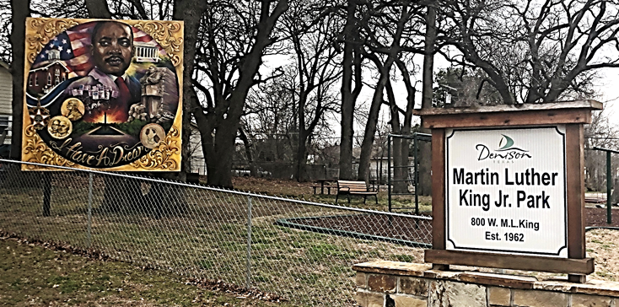
Quality of Life Improvement in Denison Neighborhood Parks
Ray Park – Unsafe Equipment removed and New Playground Equipment Installed including equipment for children with special needs
Martin Luther King Park – Installed new playground equipment, resurfaced basketball court, installed new basketball goals and a mural of MLK.
Hopkins Park – Refurbished playground equipment, installed a basketball court and basketball goal and added a pavilion

Slide 31
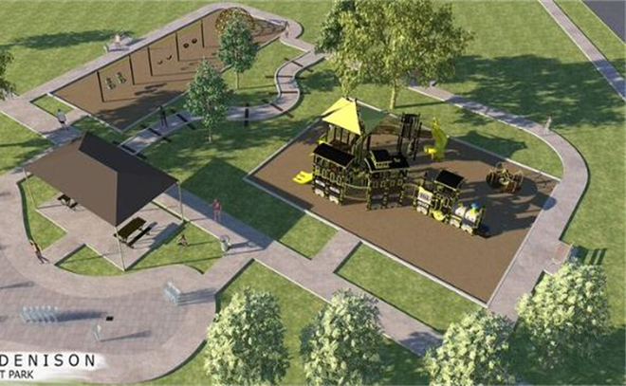
Quality of Life Improvement in Denison Neighborhood Parks
Forest Park – In partnership with the Denison Rotary Club Installed new playground equipment, installed splash pad, covered pavilion and new sidewalks
Waterloo Lake Regional Park – Installation of Dog Park, installed new playground equipment, Butterfly Garden. Upcoming improvements to trail system and kayak rental station.
Texoma Health Foundation Park – Upcoming installation of inclusive playground equipment

Slide 32
Street Improvements
Over $5 million invested in the past 5 years
$25 million in planned improvements over the next 5 years
Planned pedestrian improvements through new sidewalk program

Slide 33
Revitalization Initiatives Moving Denison Forward
1) Code Compliance Overview and Strategies
2) Revitalization Programs and Incentives
3) Investments in Neighborhood and Regional Parks
In Summary:
Code Compliance Officers are a critical part of our efforts to revitalize Denison neighborhoods
The City proactively offers several programs to assist in improving the quality of our housing stock
Community amenities/quality of life improvements in our parks and our downtown will continue to be updated and replaced to reflect the needs of our residents

Slide 34
Next Town Hall Event
May 14, 2020 at 6:00 p.m.
Southside Baptist Church – 3500 S. Park Avenue

